Slide 1
Digital Portfolio
STUDENT NAME: Navina T
REGISTER NO AND NMID: 2428CO492 & CDFBD7895C82229AD3A403310846CFF6
DEPARTMENT: II B.SC AIML
COLLEGE: KPR COLLEGE OF ARTS SCIENCE AND RESEARCH

Slide 2
DIGITAL PORTFOLIO The Fitness Trainer Portfolio is a personal website created to showcase the trainer’s skills, services, achievements, and client results. It acts as a digital profile that highlights training programs, pricing plans, testimonials, and contact details in one place. This portfolio helps the trainer to: Build professional credibility online. Attract new clients through clear service offerings. Share success stories and client transformations. Provide an easy way for people to connect and book sessions. It is designed with a simple layout, user-friendly navigation, smooth scrolling, and a contact form, making it accessible for students, job seekers, freelancers, and professionals who want to improve their fitness.

Slide 3


AGENDA
Problem Statement
Project Overview
End Users
Tools and Technologies
Portfolio design and Layout
Features and Functionality
Results and Screenshots
Conclusion
Github Link
3/21/2024 Annual Review

Slide 4

PROBLEM STATEMENT
Many people struggle to achieve their fitness goals due to lack of proper guidance, inconsistent workout routines, and limited knowledge about nutrition and exercise techniques. This often leads to loss of motivation, poor results, and even risk of injury. There is a need for a personalized, structured, and motivating fitness training approach that helps individuals improve their health, build strength, and maintain long-term wellness.

Slide 5

PROJECT OVERVIEW
This portfolio showcases my work as a professional fitness trainer, highlighting my approach to guiding individuals toward healthier lifestyles. The project focuses on creating personalized fitness plans, combining strength training, cardio, flexibility, and nutrition guidance to help clients achieve their goals effectively and safely. It also emphasizes motivation, progress tracking, and building sustainable habits. The portfolio demonstrates my training philosophy, client success stories, and the value of structured fitness programs in improving overall well-being.

Slide 6

WHO ARE THE END USERS?
Fitness Enthusiasts / Students
College or school students interested in health, fitness, or sports training.
Looking for affordable beginner-friendly coaching plans.
Job Seekers (Career-oriented clients)
People who want to improve fitness for job requirements (e.g., police, army, sports trials).
Need structured training programs to meet physical benchmarks.
Freelancers / Busy Professionals
Individuals with flexible schedules but inconsistent routines.
Need online coaching, quick workouts, or personalized diet guidance.
Working Professionals
Office workers dealing with stress, weight gain, or posture issues.
Need long-term plans for strength, mobility, and lifestyle improvement.

Slide 7

TOOLS AND TECHNIQUES
Tools Used
HTML5 – for structure (headings, sections, forms, navigation).
CSS3 – for styling (colors, fonts, layout, responsive design).
Web Browser – Google Chrome – to test and run the portfolio.
Code Editor – CodePen – to write and preview HTML & CSS online.
Hosting Tools – GitHub Pages to publish online.
Techniques Used
Single-Page Layout – All sections (services, pricing, testimonials, contact) are on one scrollable page.
Navigation Menu with Anchors – Clicking menu links smoothly jumps to each section.
Responsive Design – Uses CSS Grid so layout adapts on desktop, tablet, and mobile.
Typography & Colors – Simple fonts (Arial), consistent theme (orange + dark gray).
Contact Form – Allows users to send a quick message (name, email, message).
Footer & Branding – Includes trainer name and copyright.

Slide 8
POTFOLIO DESIGN AND LAYOUT
Header & Navigation
Trainer’s name, tagline, and menu links (Services, Plans, Testimonials, Contact).
Fixed at the top for easy access.
Plans / Pricing Section
Different packages (4 weeks, 12 weeks, 24 weeks).
Each shown in separate boxes with price & features.
Testimonials Section
Client reviews displayed in small cards.
Builds trust and credibility.
Contact Section
Contact form (Name, Email, Message).
Also lists trainer’s email, phone, and location.
Footer
Simple copyright line.
Quick links to sections.
1.
8

Slide 9
FEATURES AND FUNCTIONALITY
Navigation Bar
Fixed at the top for easy access.
Provides quick links to all sections (Services, Plans, Testimonials, Contact).
Improves user experience with clear structure.
Smooth Scrolling
Clicking a menu link smoothly scrolls to the target section.
achieved with CSS property scroll-behavior: smooth.
Makes navigation professional and user-friendly.
Contact Form
Collects user details (Name, Email, Message).
Allows potential clients to easily reach the trainer.
Can be connected to email services or form handlers.

Slide 10
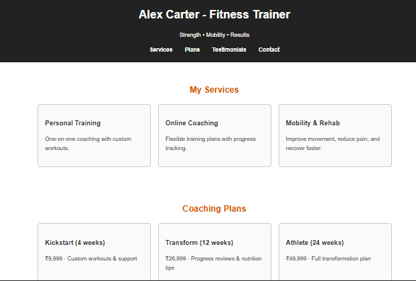
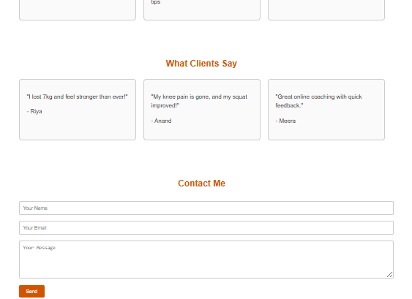

RESULTS AND SCREENSHOTS
3/21/2024 Annual Review
10

Slide 11
CONCLUSION
The Fitness Trainer Portfolio is a well-structured and user-friendly website designed to showcase services, plans, testimonials, and contact details in one place.
It uses HTML5, CSS3, and CodePen for development and testing, with a clean single-page layout.
The design focuses on simplicity, clarity, and responsiveness, ensuring accessibility across devices.
The portfolio helps the trainer build trust, attract clients, and promote services effectively.
It is useful for students, job seekers, freelancers, and professionals looking for fitness guidance.
11

